Slide 1
ERP - Return not created, error check Guide

Slide 2
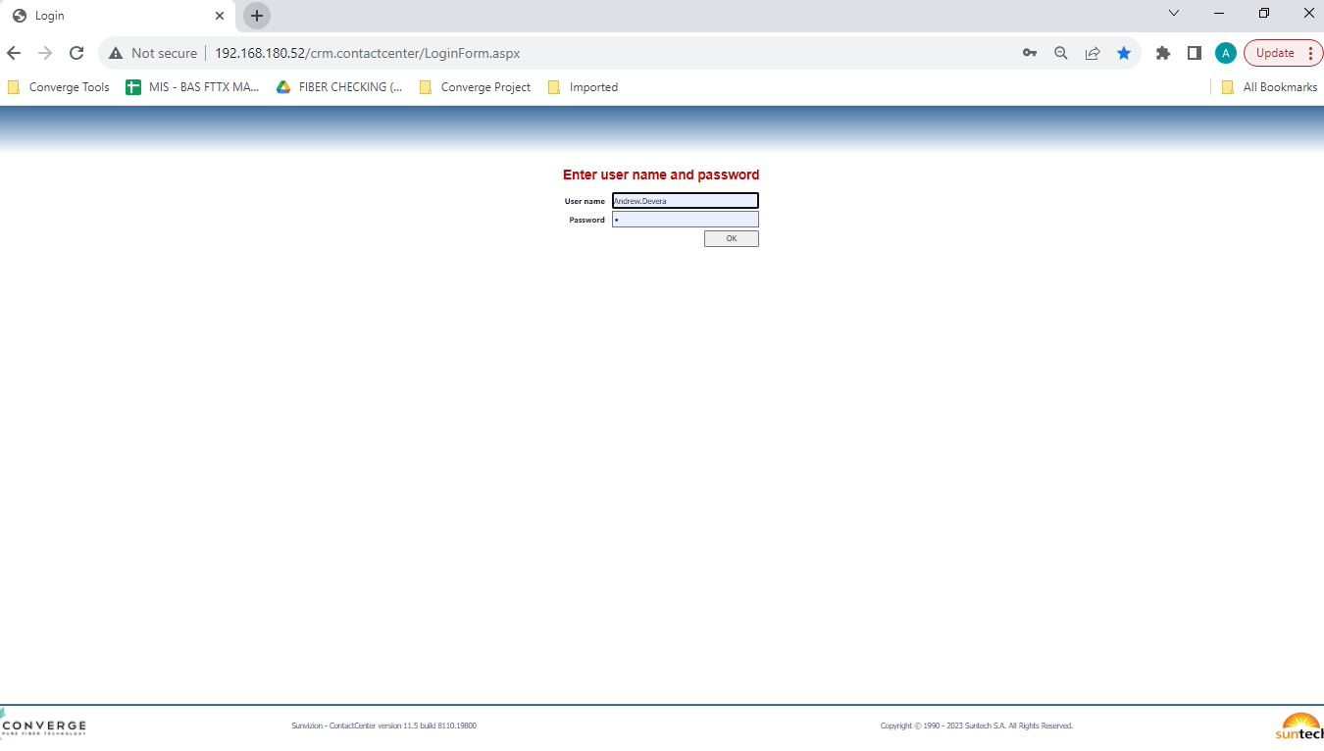
Username: Andrew.Devera
Password: 0
Then click ok.

Slide 3
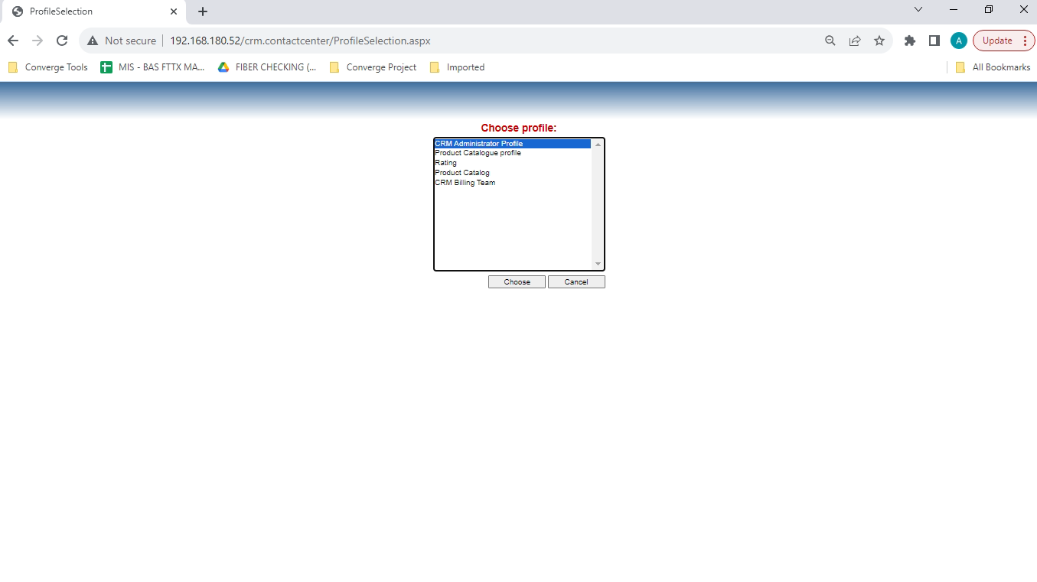
Click Choose button

Slide 4
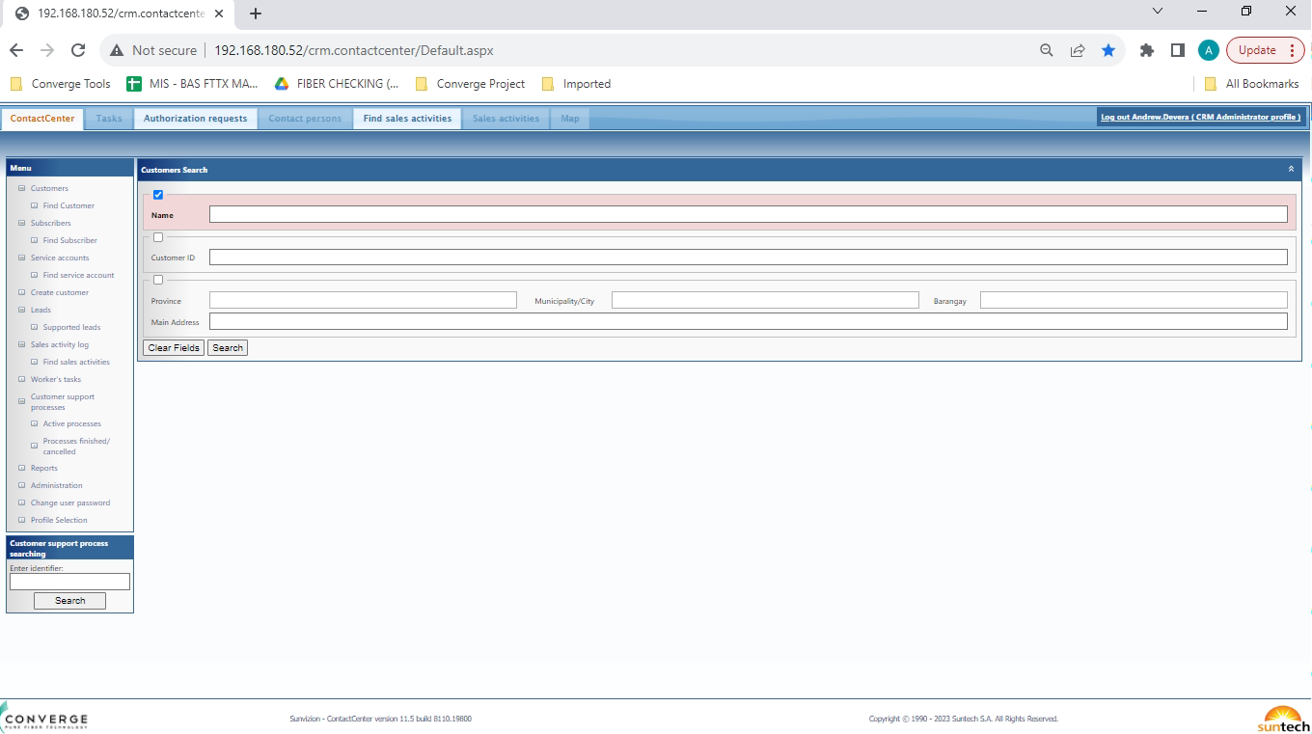
Click Worker’s Task

Slide 5
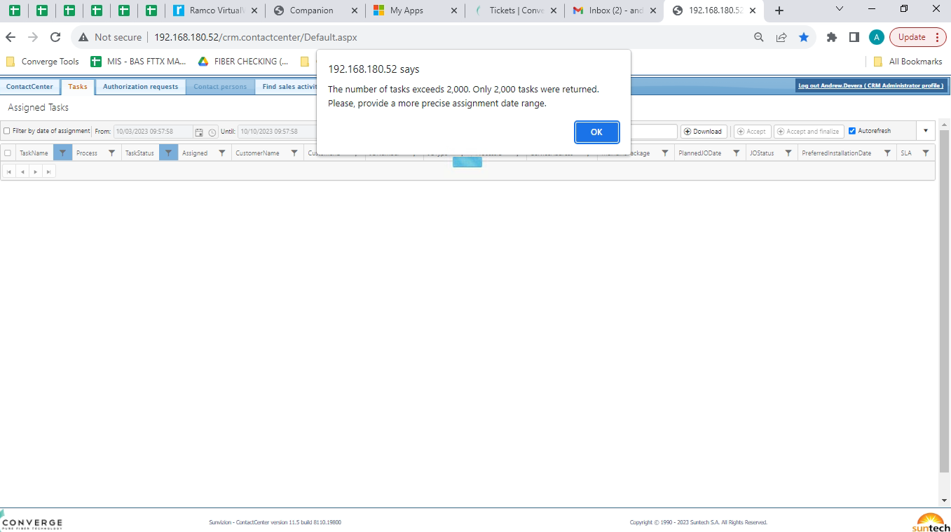
Pop-up will come out if tasks exceeds more than 2000. Click Ok button.

Slide 6
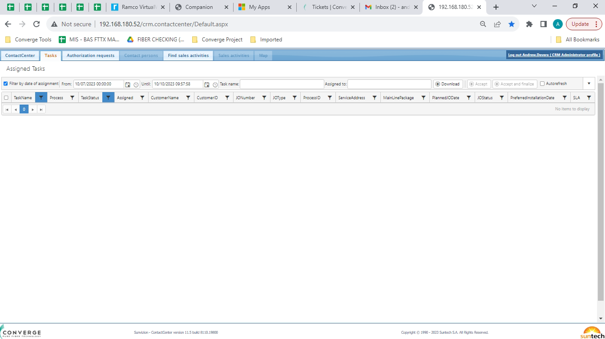
Check “Filter by date of assignment” on checkbox
From: (date should be less than 3 days. For example, today is October 10, it should be 10/07/2023 00:00:00)
Uncheck “Autorefresh” checkbox
Click “Download”

Slide 7
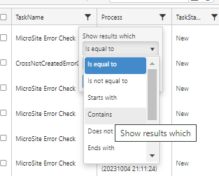
1. Click Funnel symbol in TaskName column
2. On ”Show results which”, select “Contains”

Slide 8
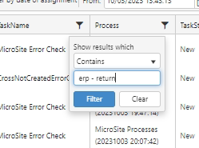
1. Type “erp - return” on search bar
2. Click “Filter” button

Slide 9
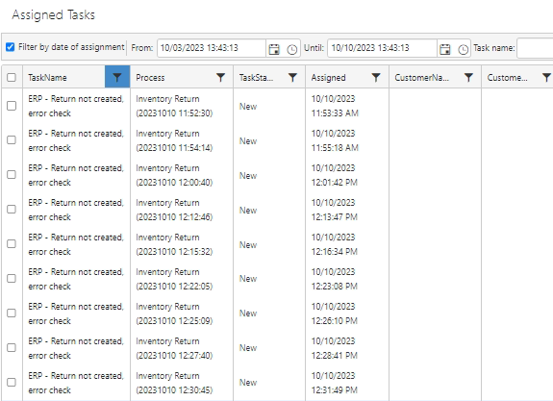
The list will filter to come out on after TaskName

Slide 10
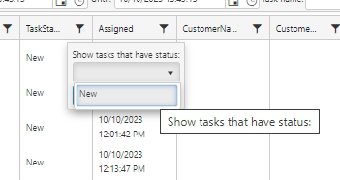
1. Click Funnel symbol in TaskStatus column
2. On ”Show tasks that have status”, select “New”

Slide 11
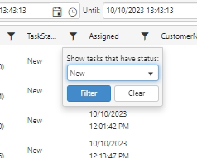
Click “Filter” button

Slide 12
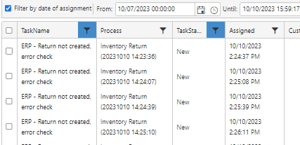
The list will filter to come out on after TaskStatus.
Click “ERP – Return not created, error check” link to proceed.
Note: It must consume all links to process.

Slide 13
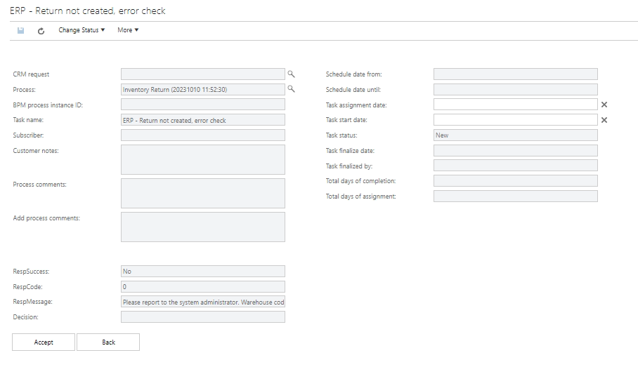
Click “Accept” button.

Slide 14
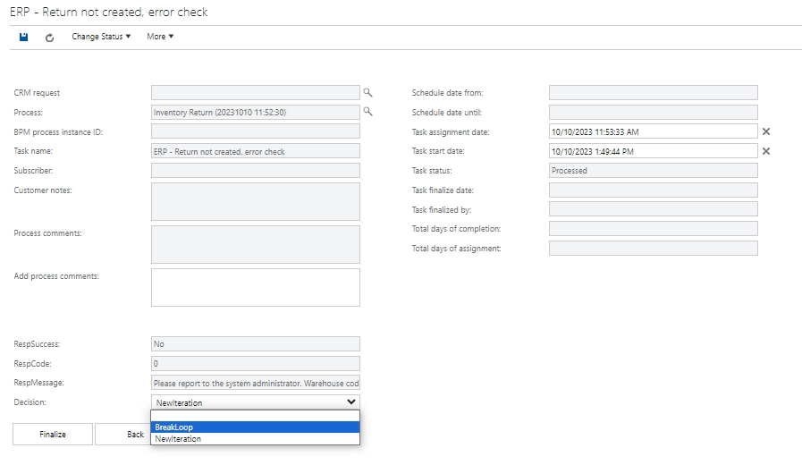
On Decision, select “BreakLoop”.

Slide 15
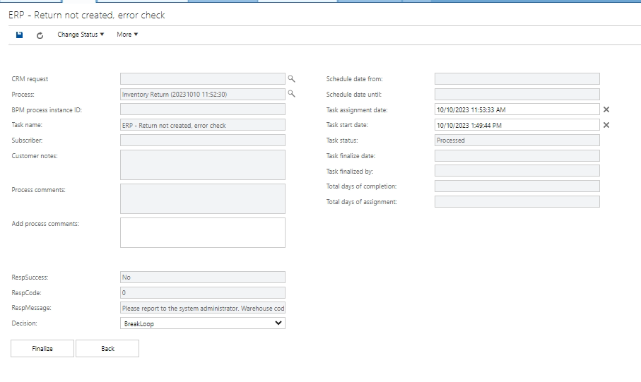
Click “Finalize” button.
Note: It will go back to Worker’s Task to click “ERP - Return” to repeat the process until all links are consumed.

